Slide 1
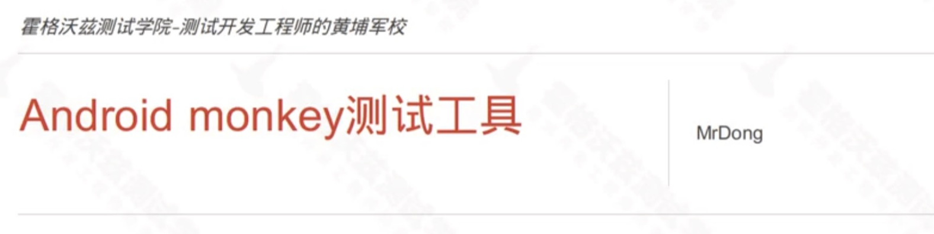

Slide 2


Slide 3


Slide 4
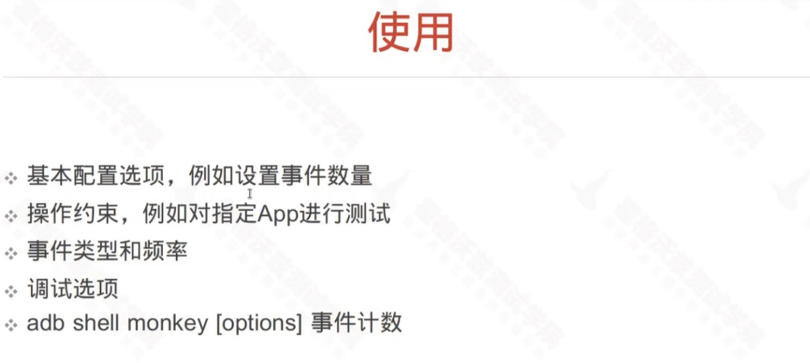

Slide 5
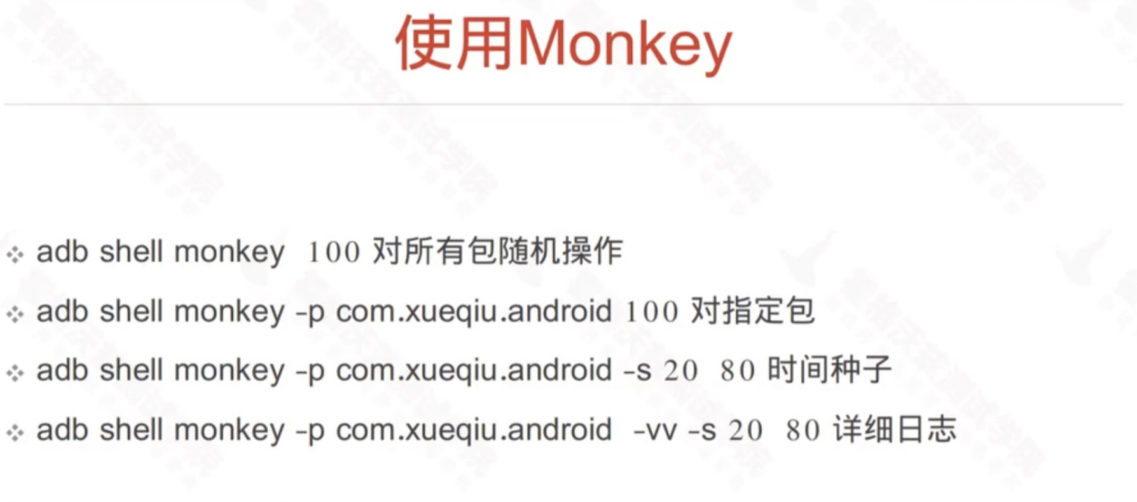

Slide 6
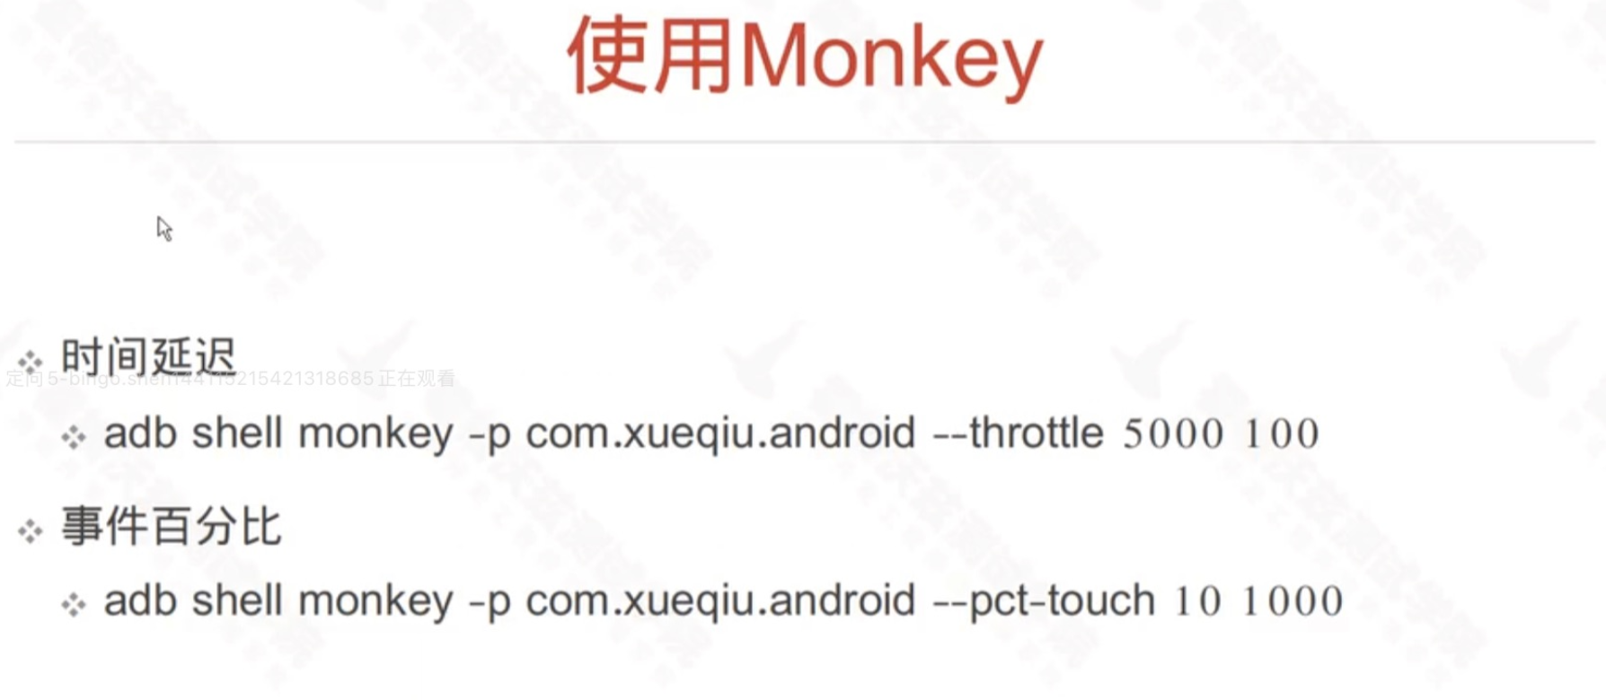

Slide 7
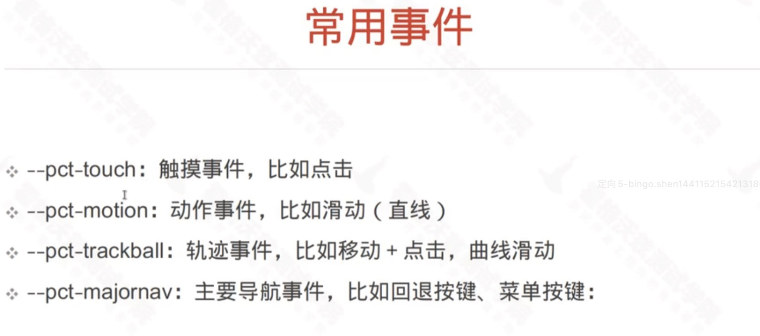

Slide 8
Maxim
https://github.com/zhangzhao4444/Maxim

Slide 9


